Slide 1
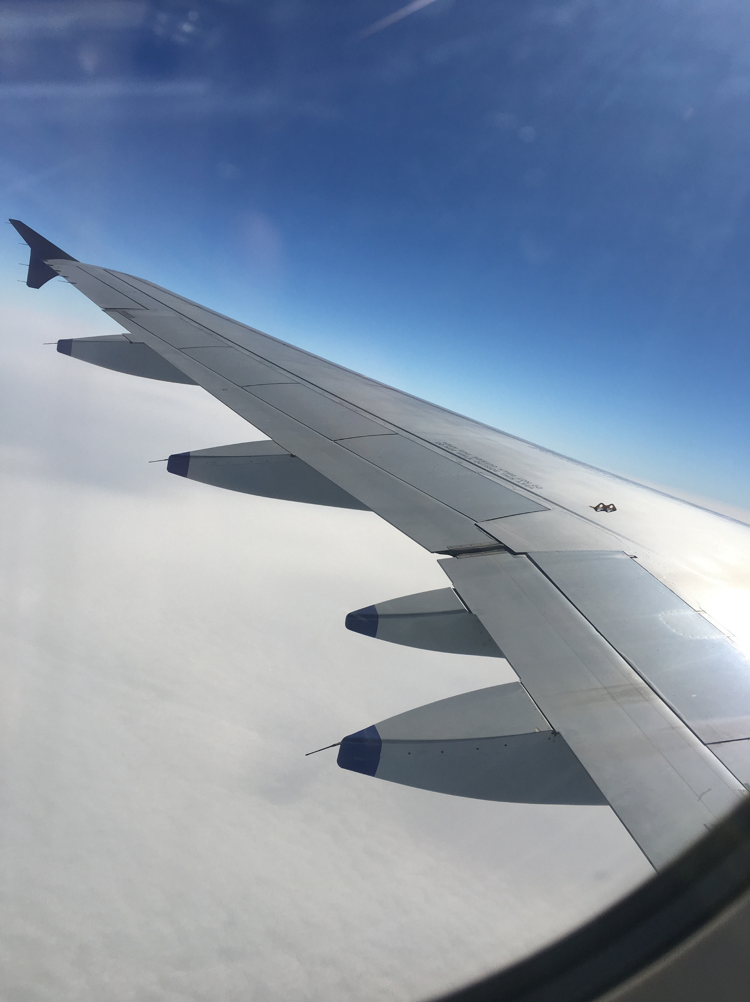
Evaluation only.
Created with Aspose.Slides for Java 19.6.
Copyright 2004-2019 Aspose Pty Ltd.

